Slide 1

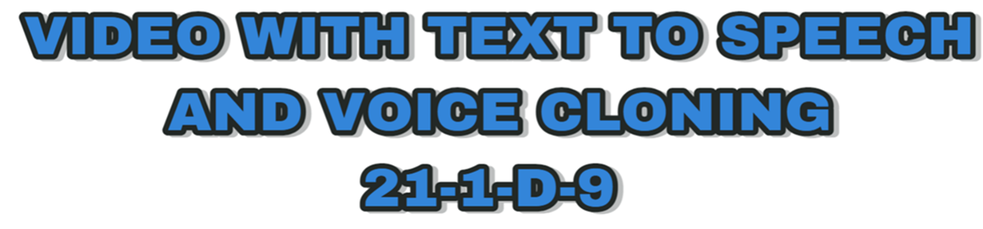
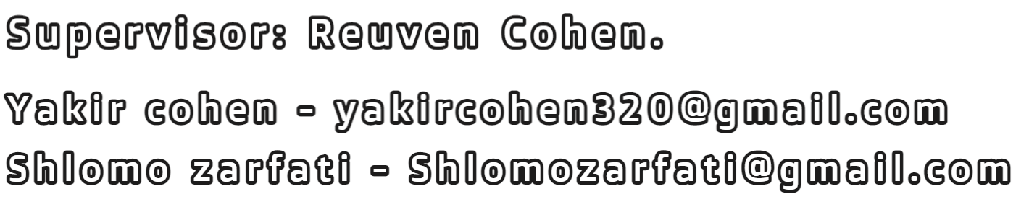


Slide 2
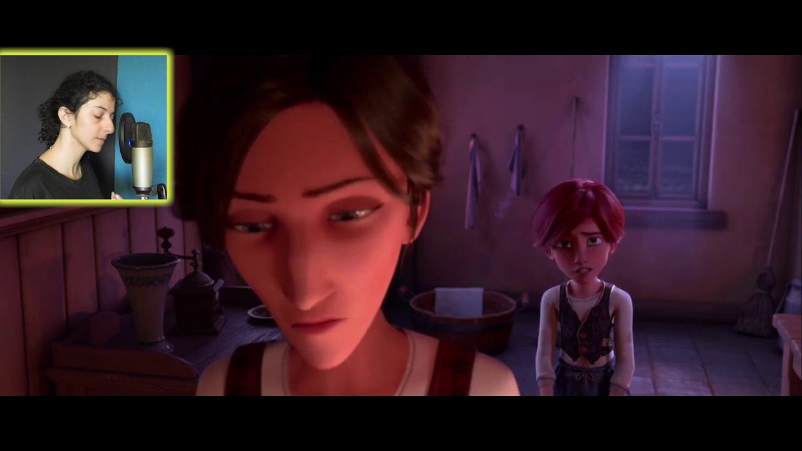
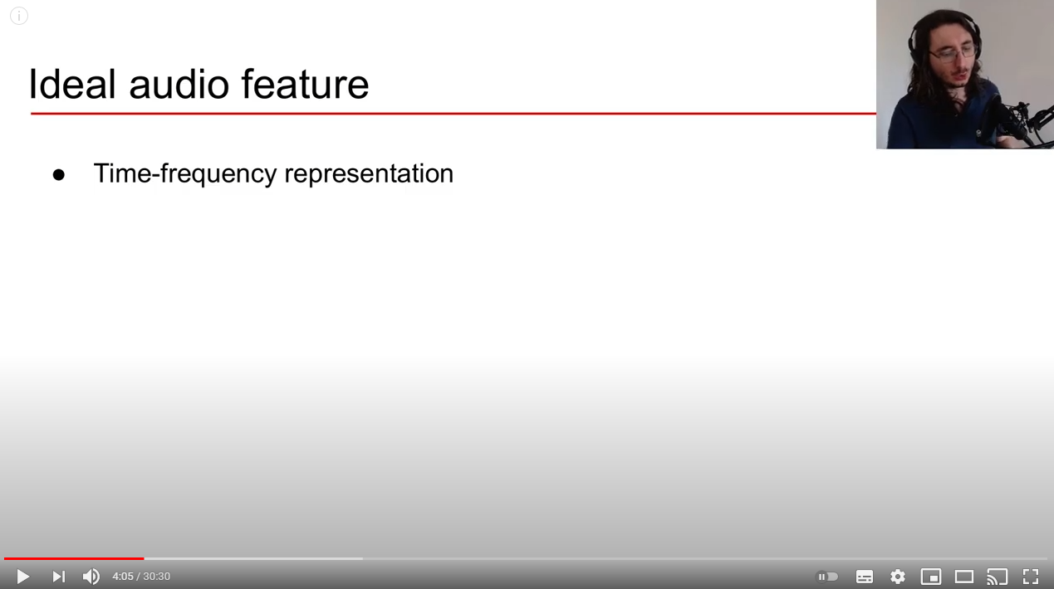
The problem
Difficulty in creating informational videos.
Hard work in making dubbing for animated films.

Slide 3
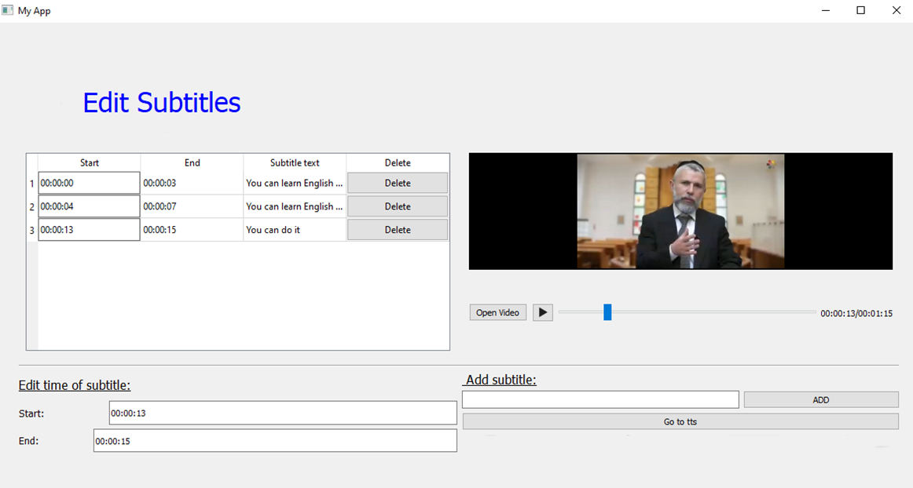
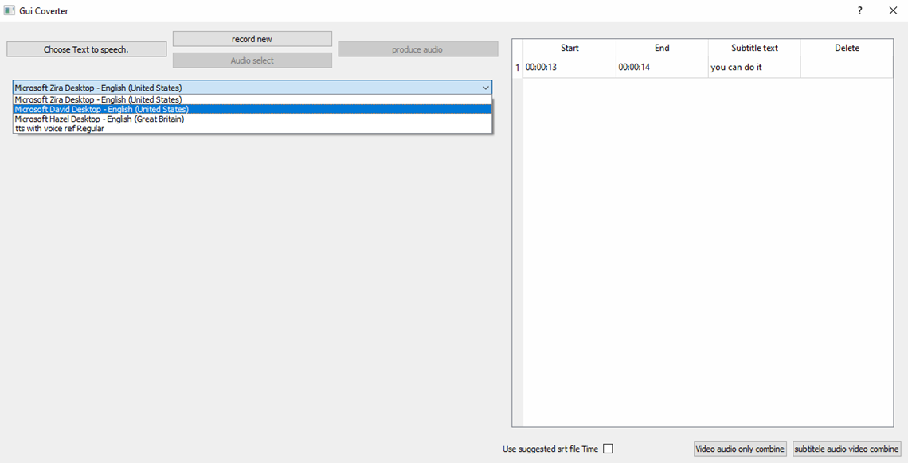

our solution
Two high level components:
Add/edit subtitles on the video.
Choose in exist speaker or Recording himself and the software Cloning his voice according to the subtitles.

Slide 4
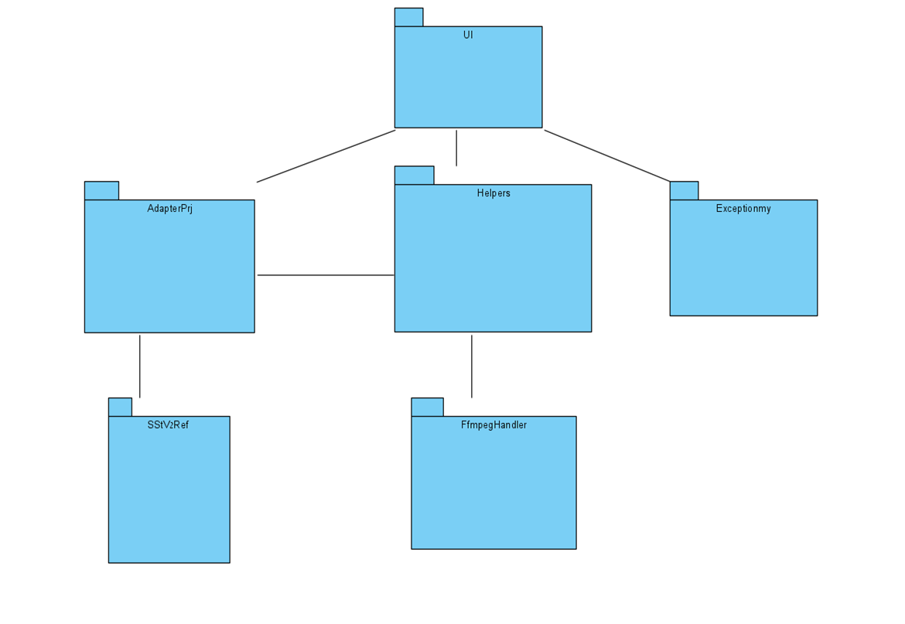
High level packaging

Slide 5
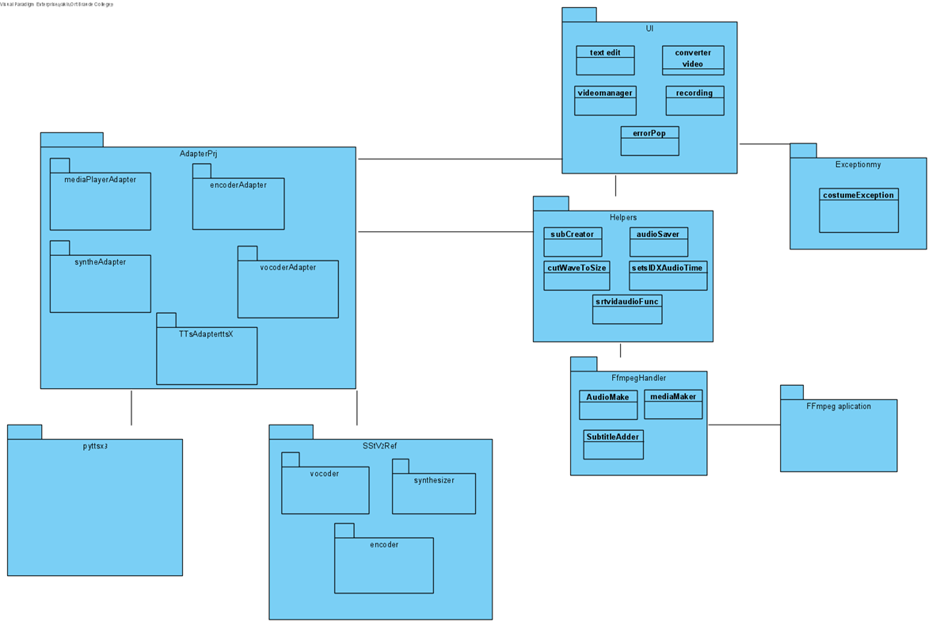
Packaging with outside packages

Slide 6
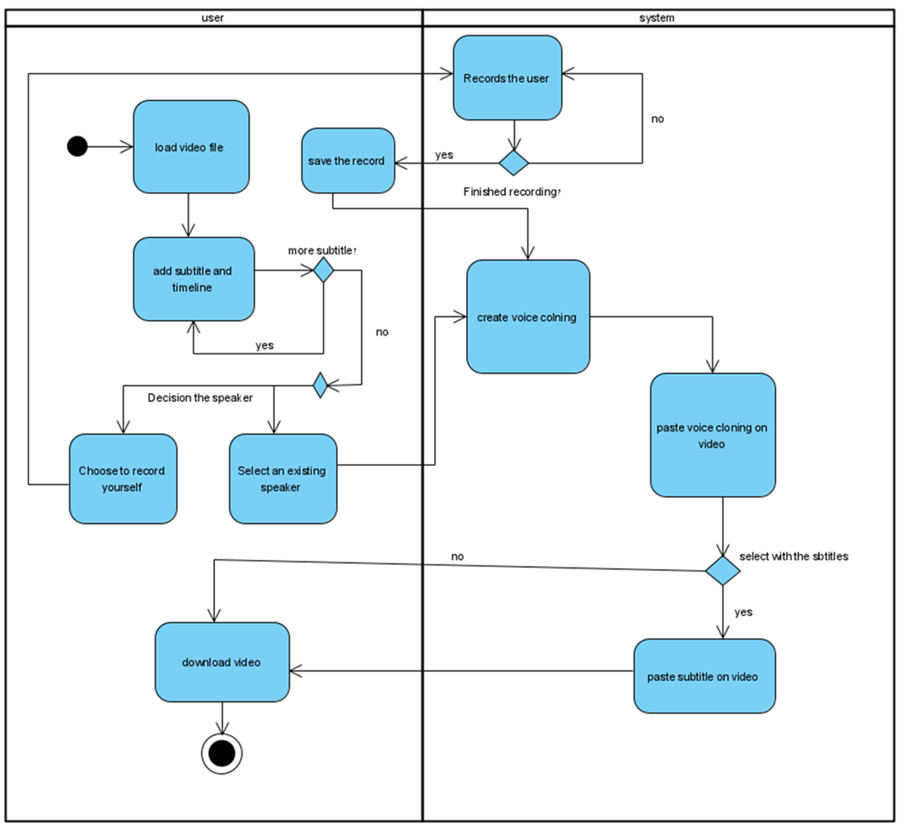

Slide 7
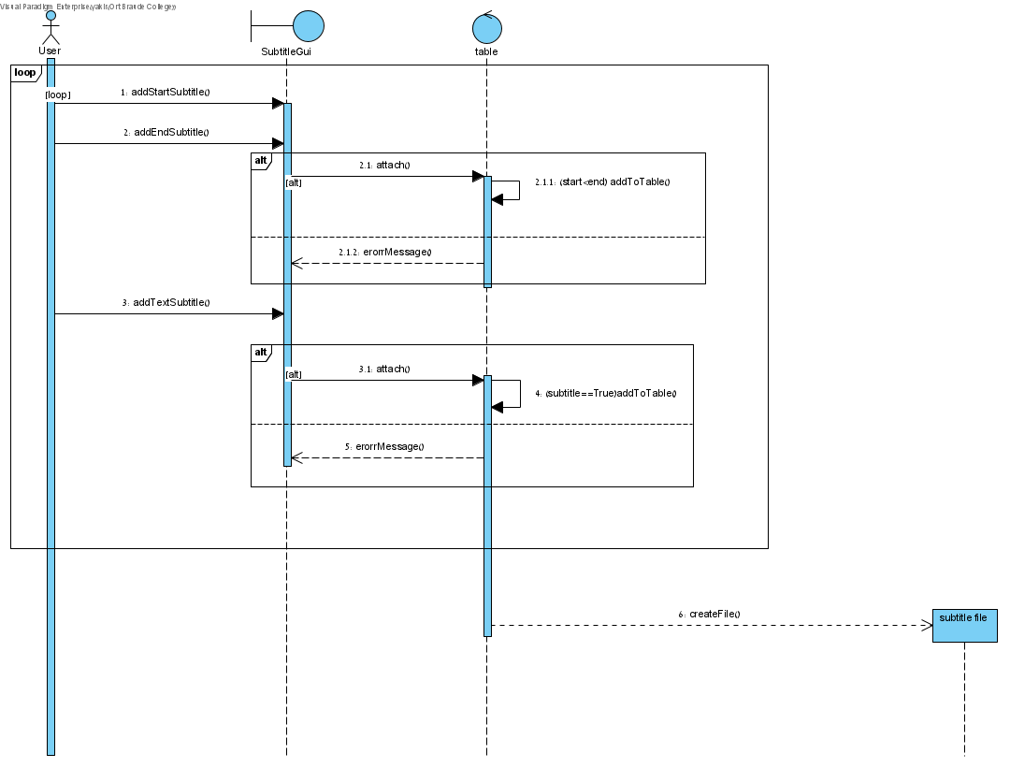
Sequence diagram- add subtitles to the table

Slide 8
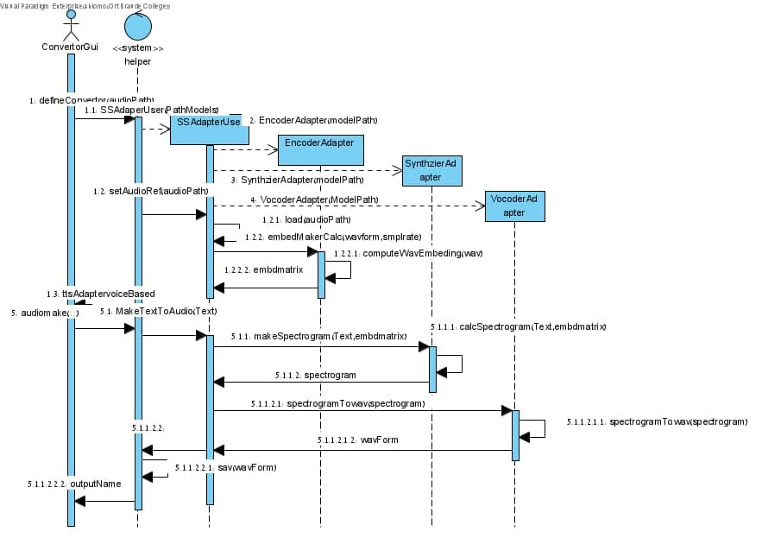
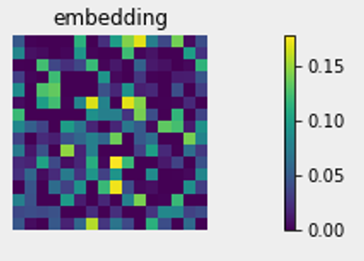
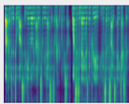
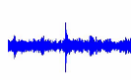
Sequence diagram- audio make with audio reference

Slide 9
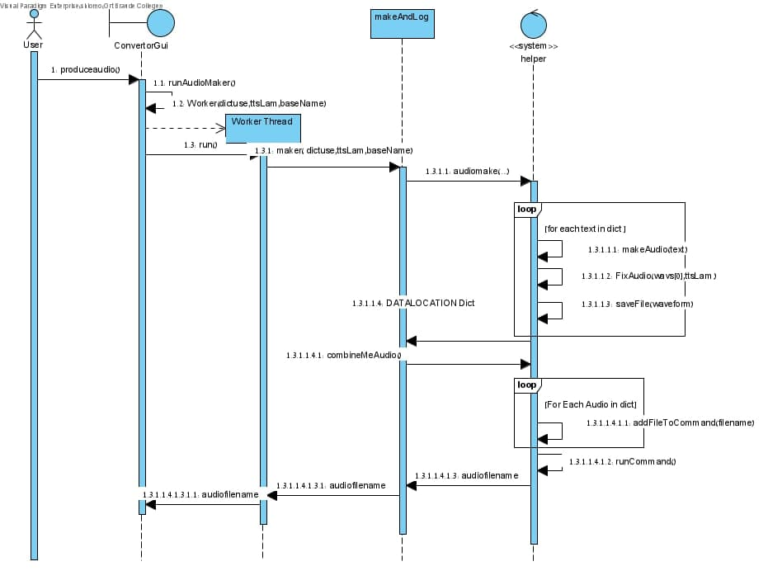
Sequence diagram-Audio file from text

Slide 10
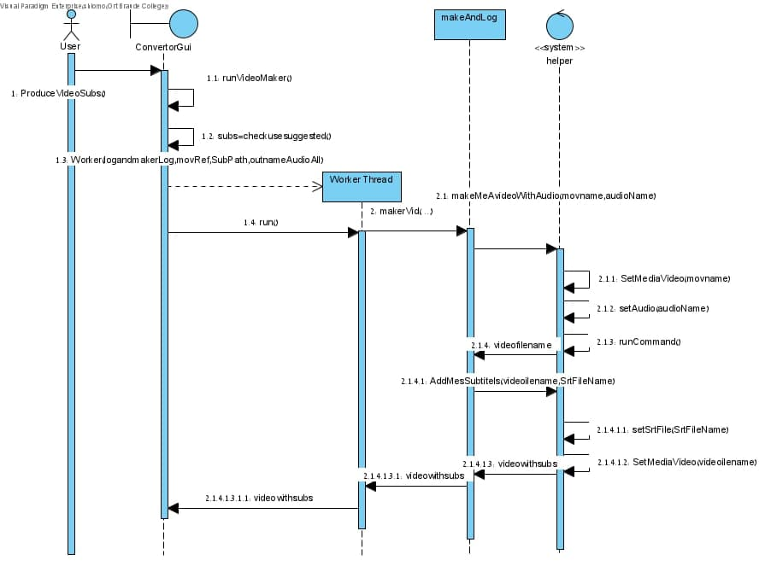
Sequence diagram- video maker

Slide 11
Now demo

Slide 12
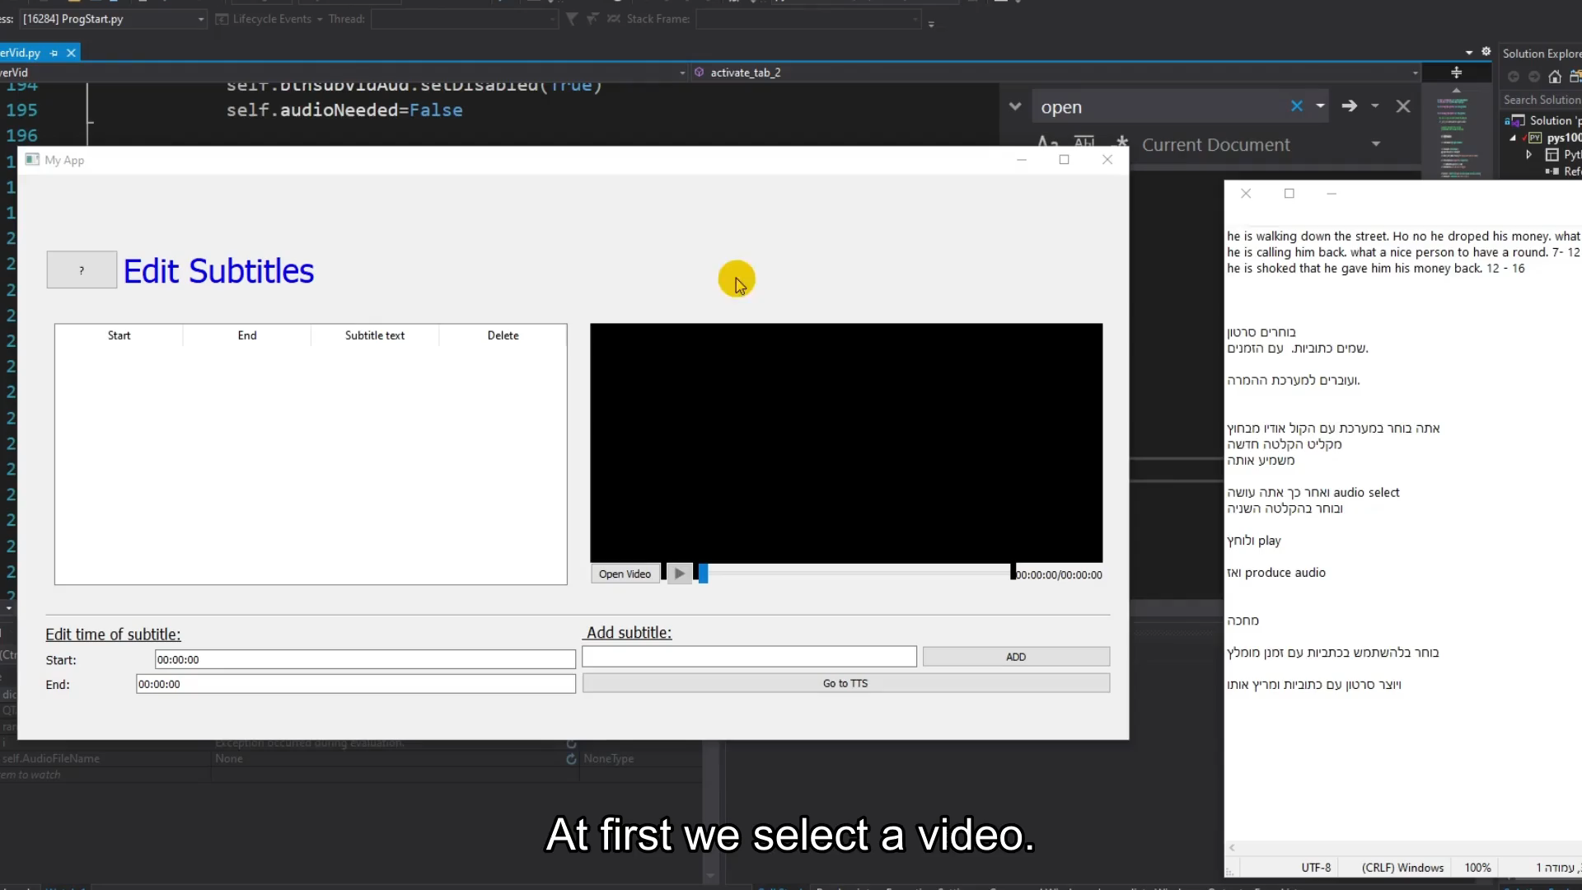

Slide 13
Testing
Actual result | Expected result | Test subject | Test No.
(survey) Fail, on certain reference audio result was 7 on other was 3.25, Average was 4.98 | An audio score about understanding 6/10 at least. From a survey. | Converting text to audio by using a reference voice. | 1
pass | A video file with text according to the subtitles file. | Adding subtitles from srt file to the video. | 2
pass | A srt file according to the srt file format. | Creating srt file. | 3
pass | Can't use a different format from hh:mm:ss while ss and mm not more then 59 | Time format | 4
pass | Subtitle table is sorted by start time. | Table sort | 5
pass | Opening a mp4 mkv file. | (UI) open a video file. | 6

Slide 14
Conclusions
Our program can translate a subtitles to a voice.
Add subtitles to a video.
Add the voice to the video in the corresponding time.
We added a tts option after a survey review.
We love the program, it could be used to make funny Tik-tok videos.

Slide 15
Challenges
Multiple usages of the same component.
Ffmpeg command line statues update.
Graphical user interface freeze.
Manage the time line of the audios.
Tts expendability.
Platform environment installing.

Slide 16
The End
Thank you for listening

